Slide 1


Volunteer Appreciation Week 2020
Notes:
JOHN:
You may remember Candy Field from the last time we were here. She is now in her second year as Auxiliary President and will conclude her term in December. Candy volunteers on a weekly basis in our Emergency Department where she also helps train new adult and college age Volunteers in that area.
Some of you may know Mary Ann Garback, either from church at Calvary Baptist or from her time in the real estate business. Mary Ann will begin as Auxiliary President next January. Mary Ann volunteers faithfully in the Gift Shop.
I’m John Walker, and I serve as Director of Volunteer Services.

Slide 2

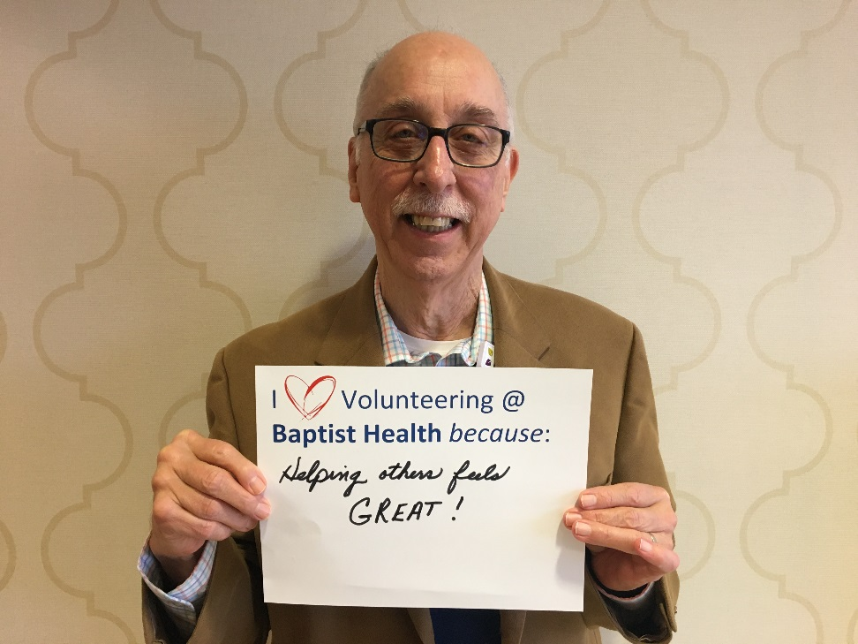
David Aiken: Speech Therapy Loud Crowd
I Volunteering @ Baptist Health because:
Helping others feels GREAT!

Slide 3
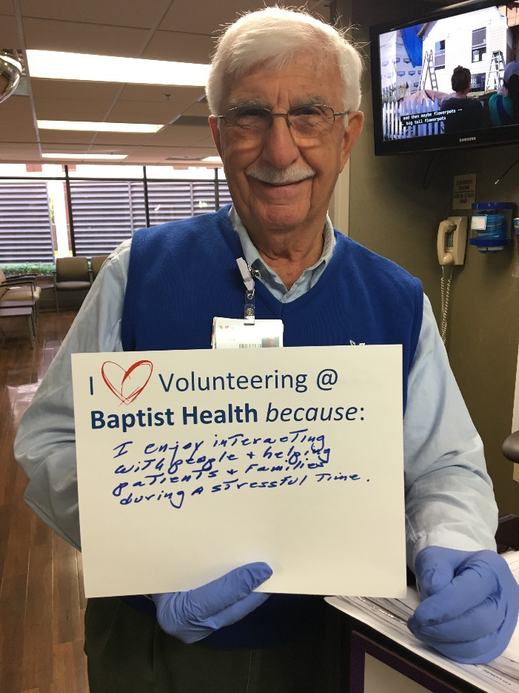
James Allison: ED Communication Liaison
I Volunteering @ Baptist Health because:
I enjoy interaction with people & helping patients and families during a stressful time.

Slide 4
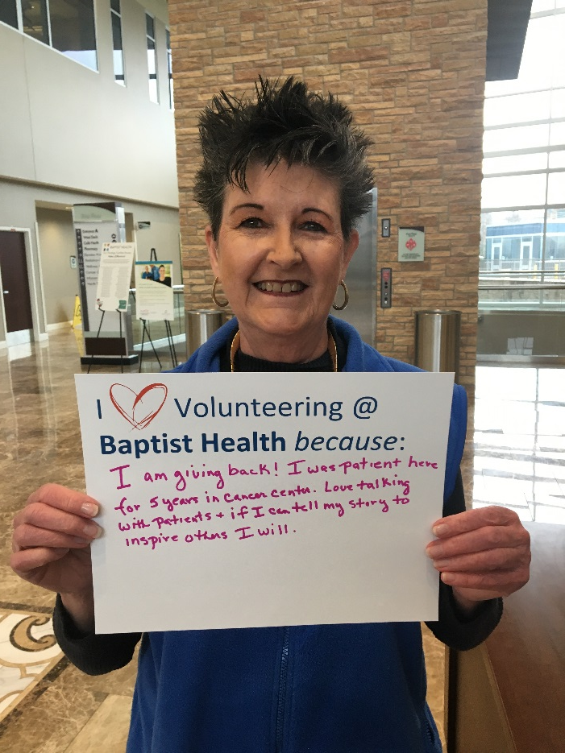
Annie Barnes: Cancer Center Information Desk
I Volunteering @ Baptist Health because:
I am giving back! I was a patient here for 5 years in the cancer center. Love talking with patients & if I can tell my story to inspire others, I will.

Slide 5
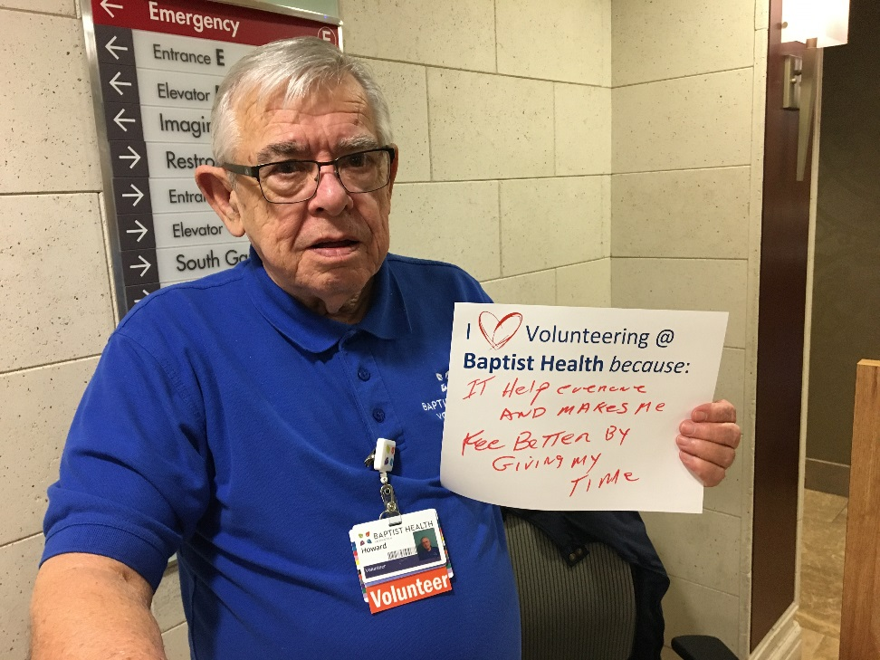
Howard Coleman: 1740 Hallway Info Desk
I Volunteering @ Baptist Health because:
It helps everyone, and it makes me feel better by giving my time.

Slide 6
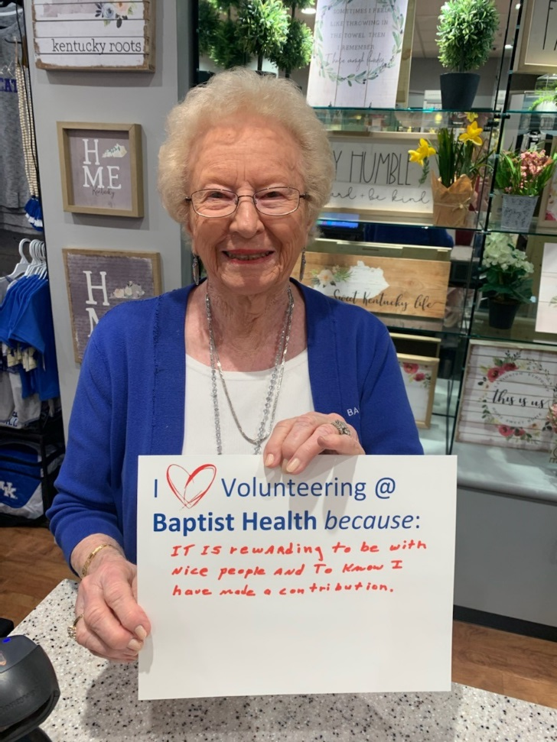
Evelyn Dalby: Gift Shop
I Volunteering @ Baptist Health because:
It is rewarding to be with nice people and to know I have made a contribution.

Slide 7
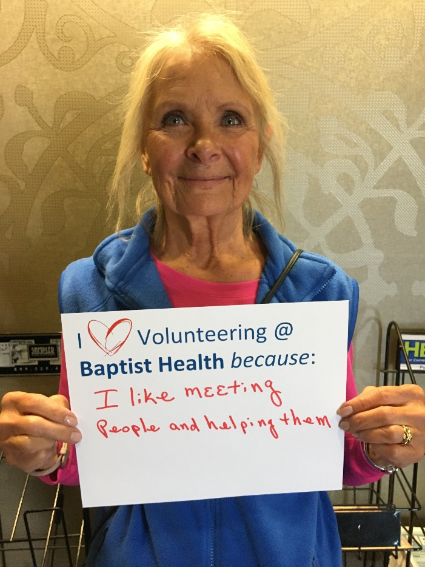
Nancy Gagnon: Falls Prevention Rounding
I Volunteering @ Baptist Health because:
I like meeting people and helping them.

Slide 8
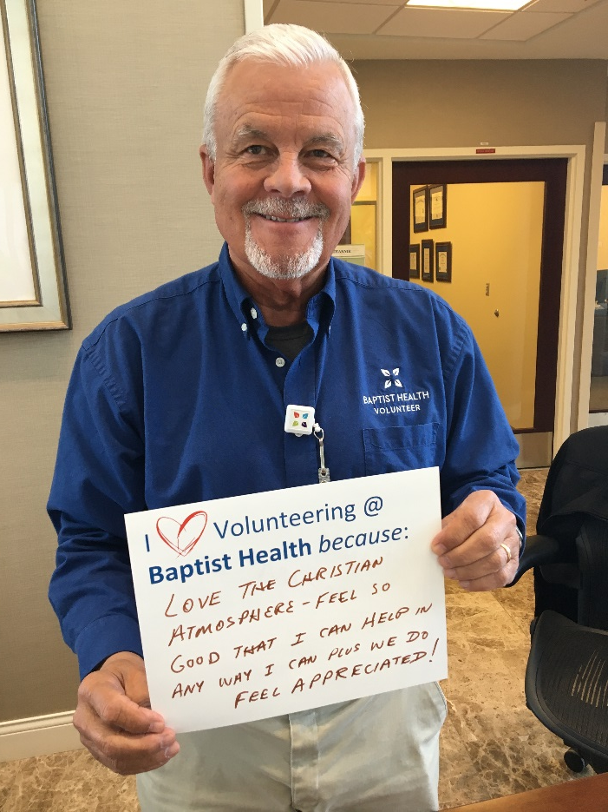
Randy Greenup: Cancer Center Info Desk
I Volunteering @ Baptist Health because:
Love the Christian atmosphere – feel so good that I can help in any way I can plus we do feel appreciated!

Slide 9
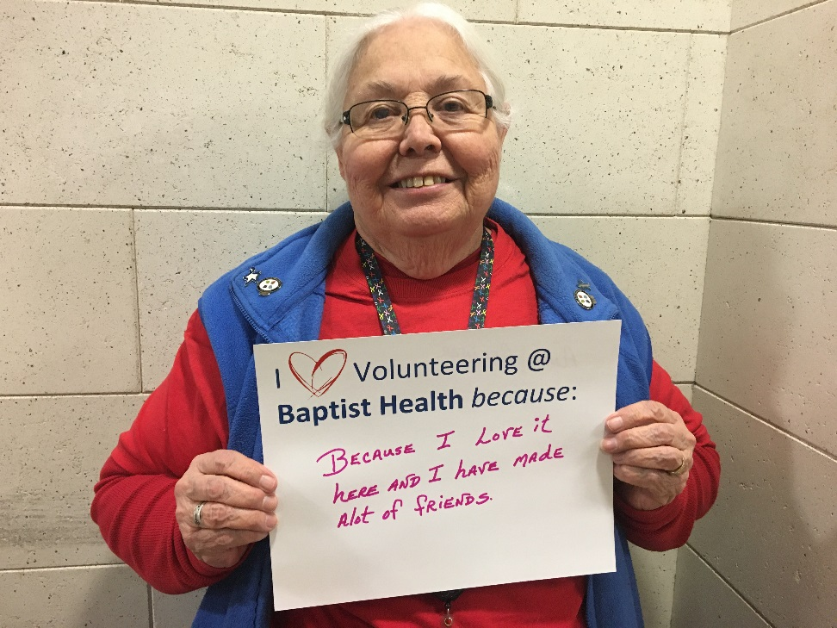
Anna Greiner: 1740 Hallway Information Desk
I Volunteering @ Baptist Health because:
I love it here and I have made a lot of friends.

Slide 10
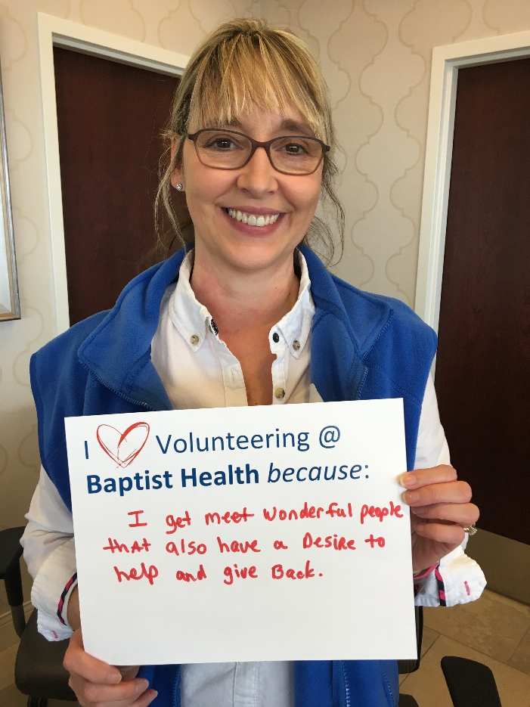
Gina Howard: NICU Reception / Flower Delivery
I Volunteering @ Baptist Health because:
I get to meet wonderful people that also have a desire to help and give back.

Slide 11
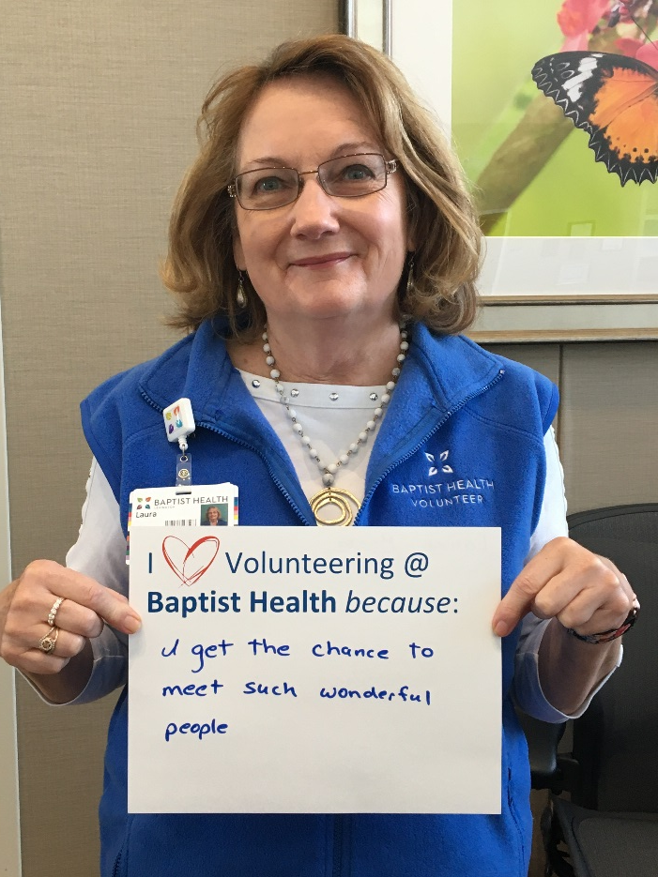
Laura Howe: Cancer Center Information Desk
I Volunteering @ Baptist Health because:
I get a chance to meet such wonderful people.

Slide 12
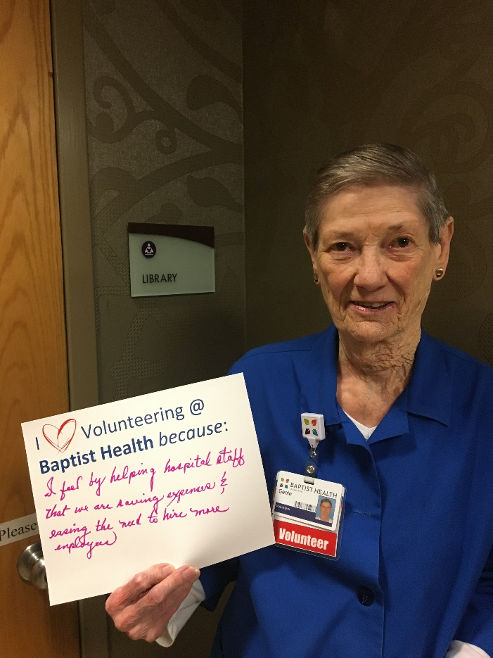
Genie Hussick: Library
I Volunteering @ Baptist Health because:
I feel by helping hospital staff we are saving expenses and easing the need to hire more employees.

Slide 13
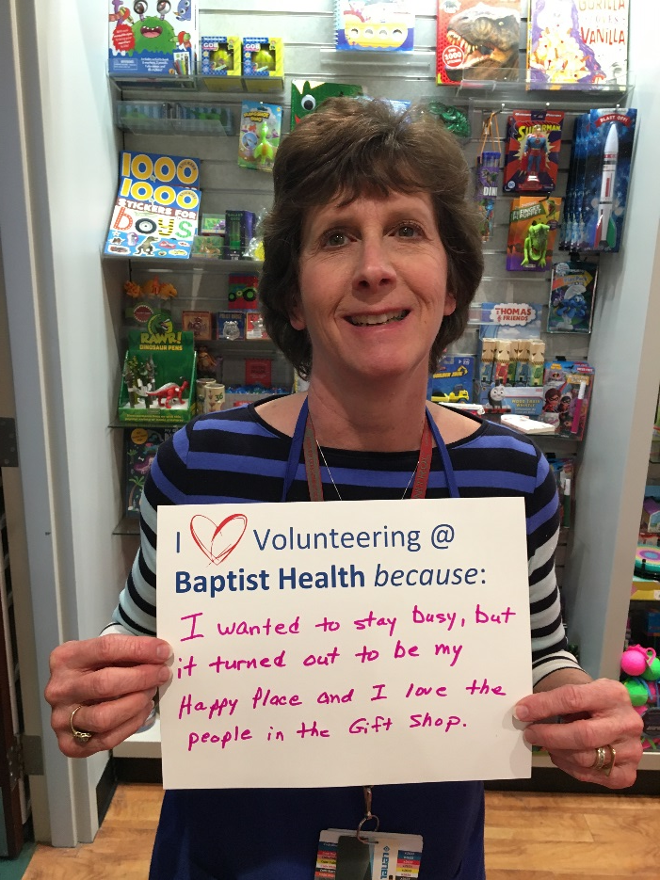
Judy Ivanchek: Gift Shop
I Volunteering @ Baptist Health because:
I wanted to stay busy, but it turned out to be my Happy time and I love the people in the Gift Shop.

Slide 14
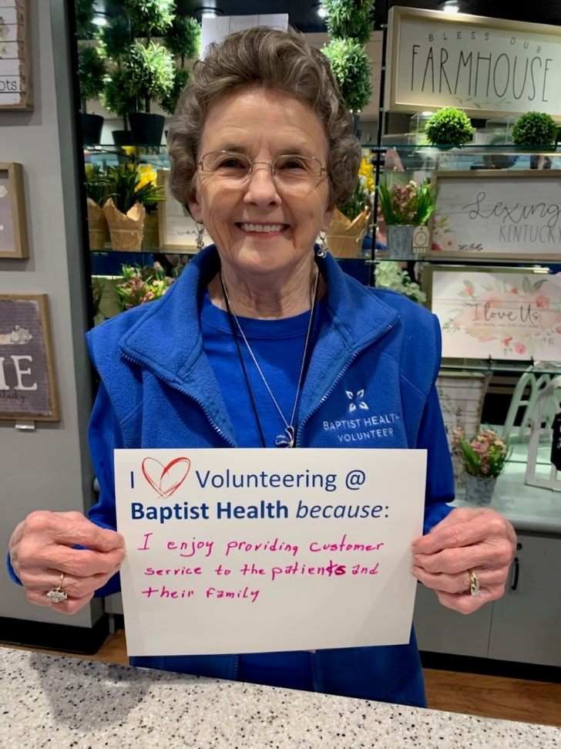
Alberta Kemplin: Gift Shop
I Volunteering @ Baptist Health because:
I enjoy providing customer service to patients and their family.

Slide 15
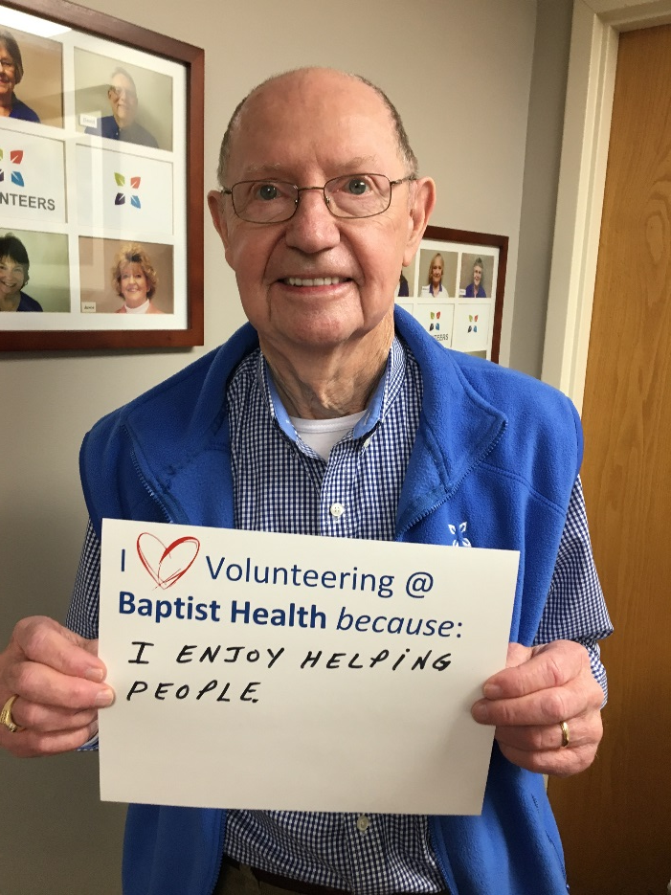
Drexell Kemplin: Surgery Waiting
I Volunteering @ Baptist Health because:
I enjoy helping people.

Slide 16
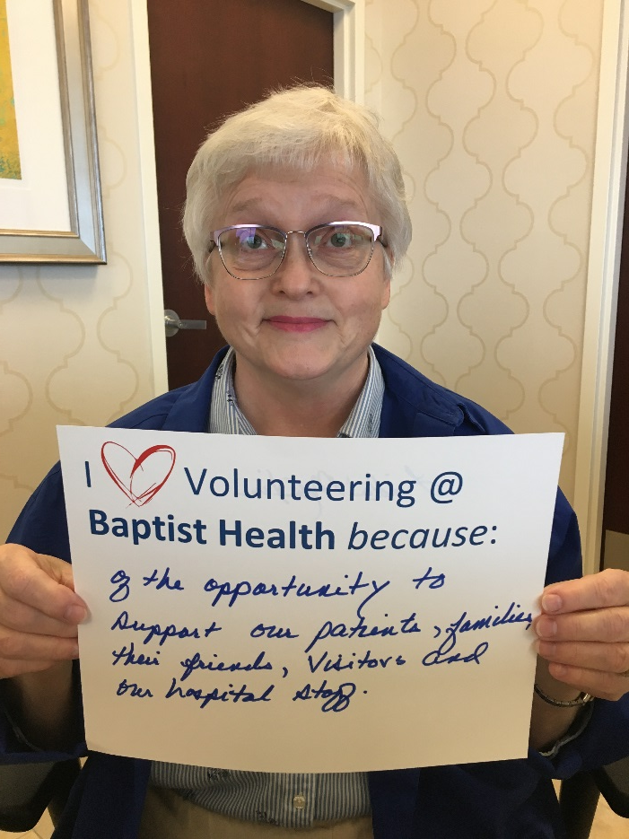
Linda Martin: NICU Reception / Flower Delivery
I Volunteering @ Baptist Health because:
Of the opportunity to support our patients, families, their friends, visitors, and our hospital staff.

Slide 17
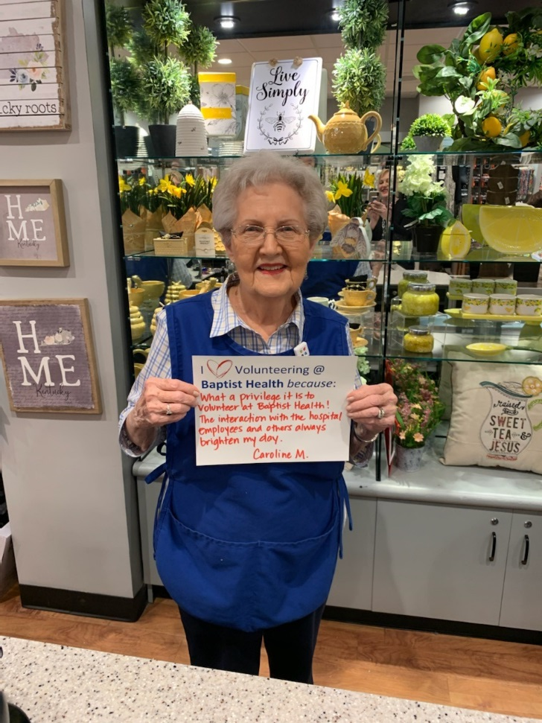
Caroline Mathis: Gift Shop
I Volunteering @ Baptist Health because:
What a privilege it is to volunteer at Baptist Health! The interaction with the hospital employees and others always brightens my day.

Slide 18
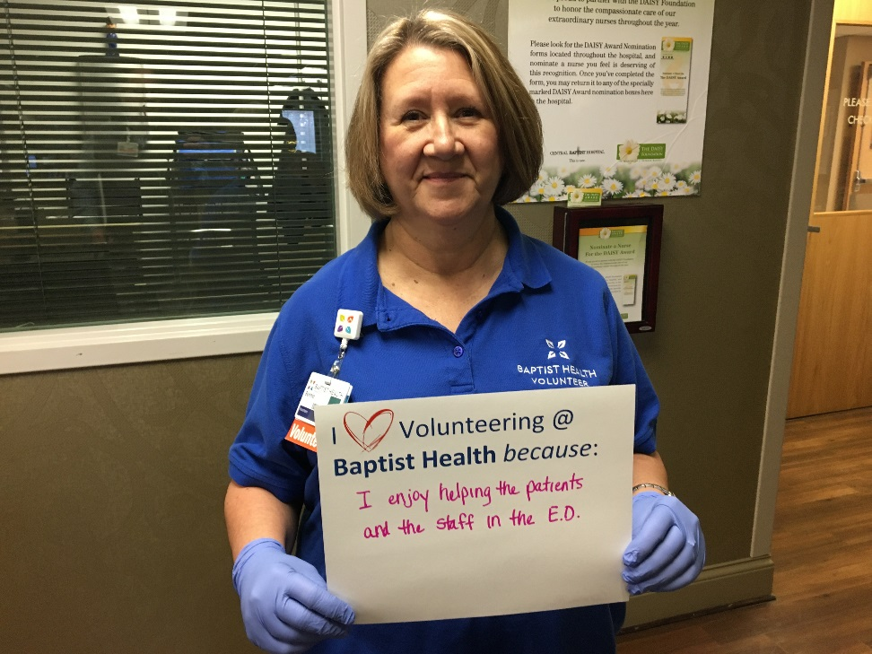
Bonnie Morris: ED Communication Liaison
I Volunteering @ Baptist Health because:
I enjoy helping the patients and the staff in the ED.

Slide 19
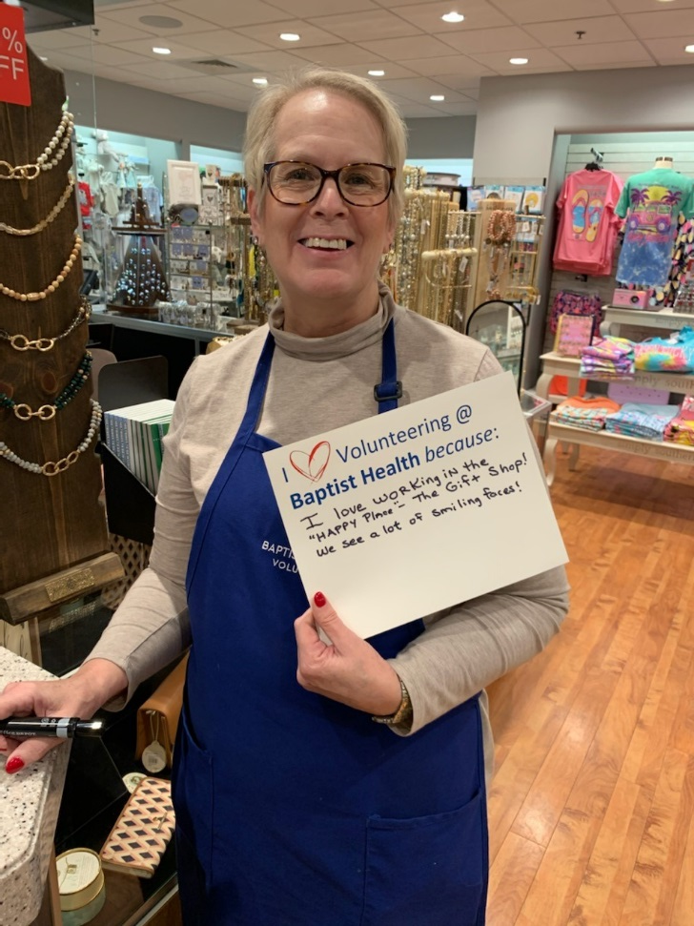
Lois Noland: Gift Shop
I Volunteering @ Baptist Health because:
I love working in the “Happy Place” – the Gift Shop! We see a lot of smiling faces.

Slide 20
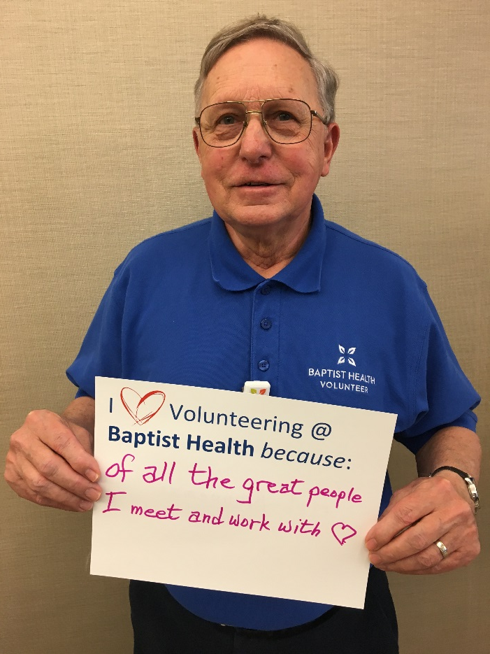
Art Nonneman: 1720 Customer Service
I Volunteering @ Baptist Health because:
Of all the great people I meet and work with!

Slide 21
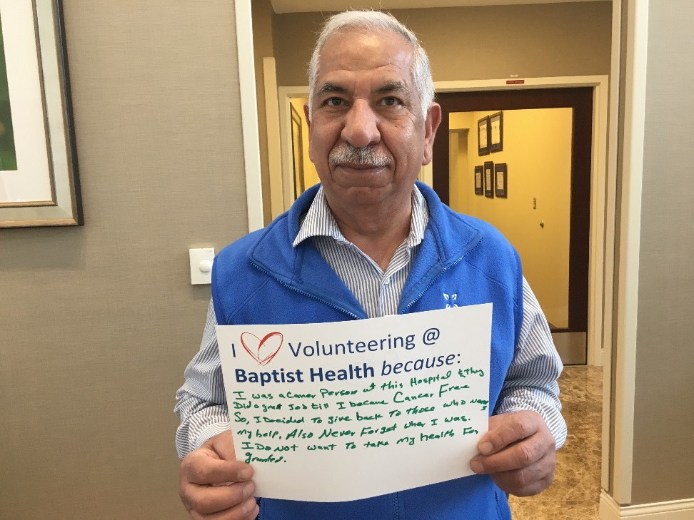
Amir Omidy: Cancer Center Info Desk & Infusion
I Volunteering @ Baptist Health because:
I was a patient of this hospital and they did a great job because I am cancer free! So, I decided to give back to those who need my help. Also, never forget where I was. I do not want to take my health for granted.

Slide 22
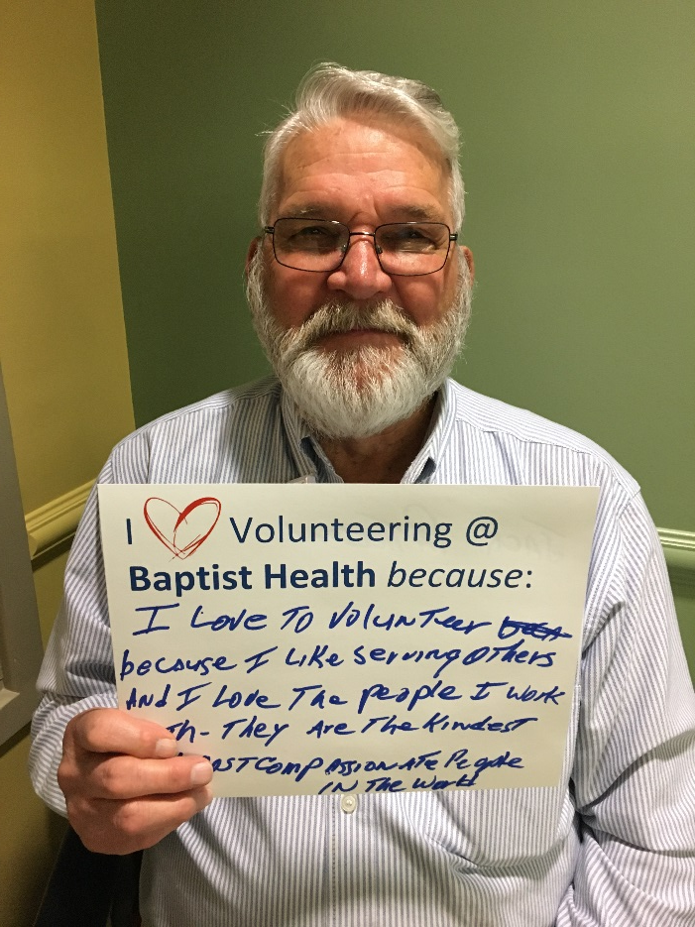
Jack Patterson: Surgery Center & NICU Reception
I Volunteering @ Baptist Health because:
I love to volunteer because I like serving others and I love the people I work with. They are the kindest, most compassionate people in the world.

Slide 23
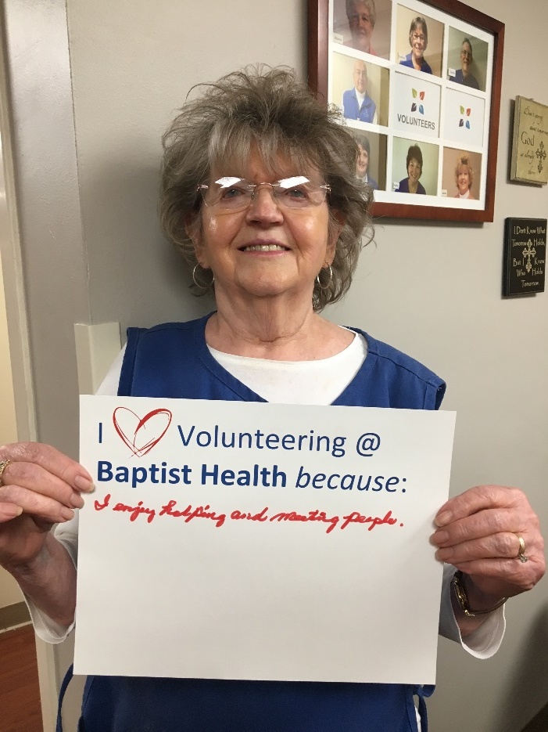
Joyce Quiggins: Surgery Waiting
I Volunteering @ Baptist Health because:
I enjoy helping and meeting people.

Slide 24
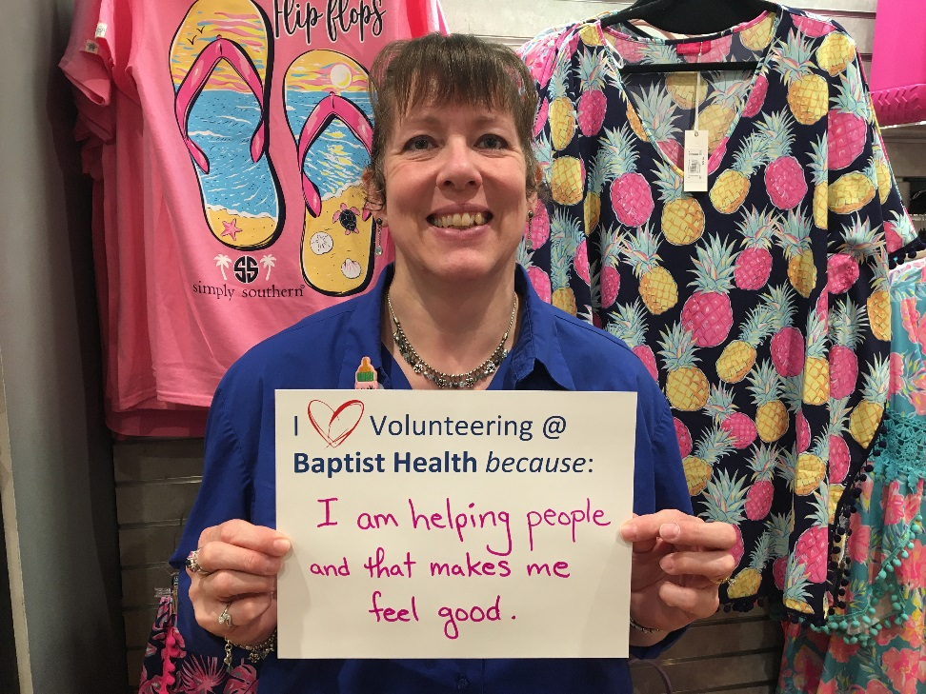
Brenda Rapske: Gift Shop
I Volunteering @ Baptist Health because:
I am helping people and that makes me feel good.

Slide 25
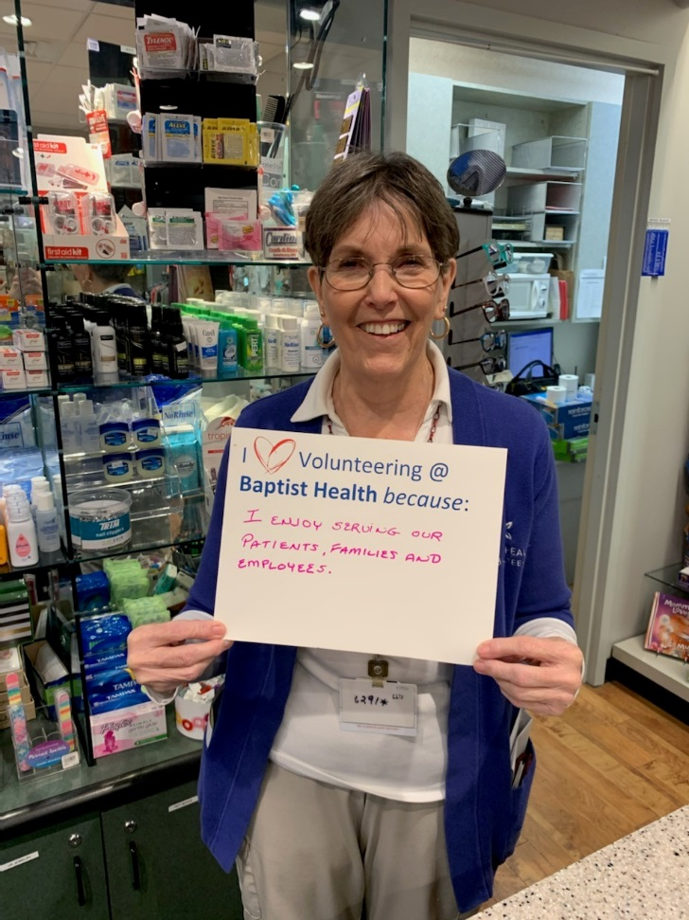
Geri Ritchey: Gift Shop
I Volunteering @ Baptist Health because:
I enjoy serving our patients, families, and employees.

Slide 26
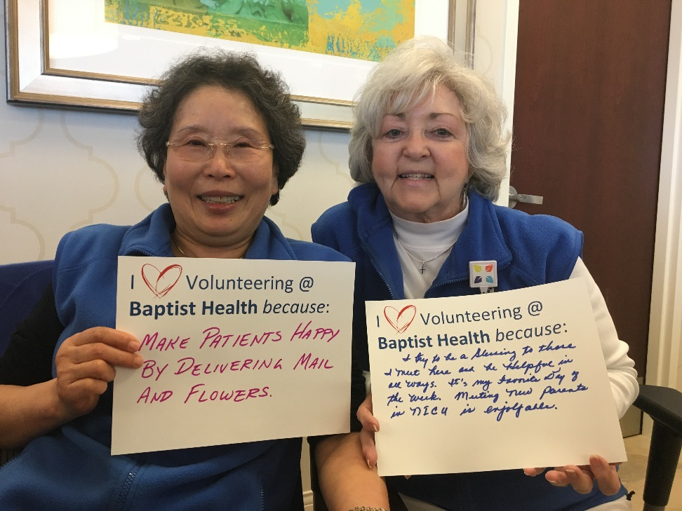
Kim Sither & Bonnie Johnson:
NICU Reception / Mail & Flower Delivery
I Volunteering @ Baptist Health because:
I make patients happy by delivering mail and flowers.
I try to be a blessing to those I meet here and helpful in all ways. It’s my favorite day of the week. Meeting new NICU parents is enjoyable.

Slide 27
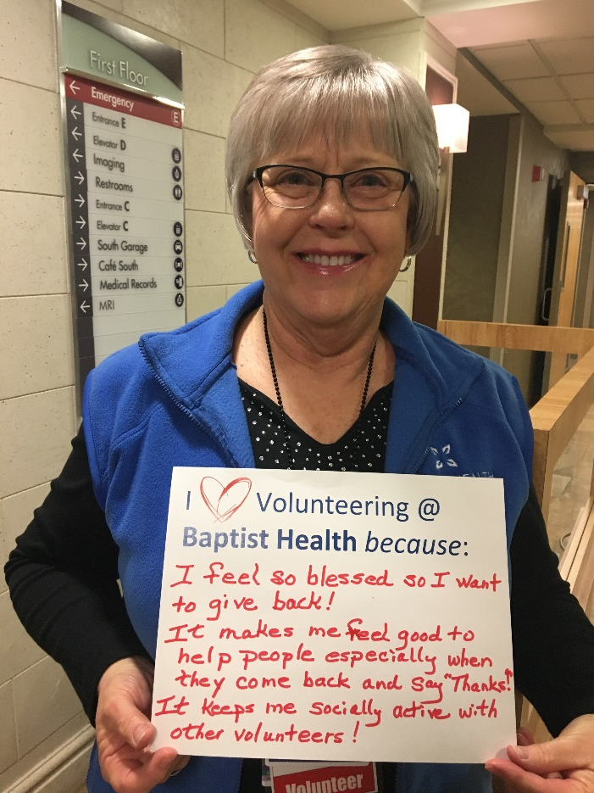
Brenda Watts: 1740 Hallway Information Desk
I Volunteering @ Baptist Health because:
I feel so blessed, so I want to give back! It makes me feel good to help people, especially when they come back and say “Thanks!” It keeps me socially active with other volunteers!

Slide 28
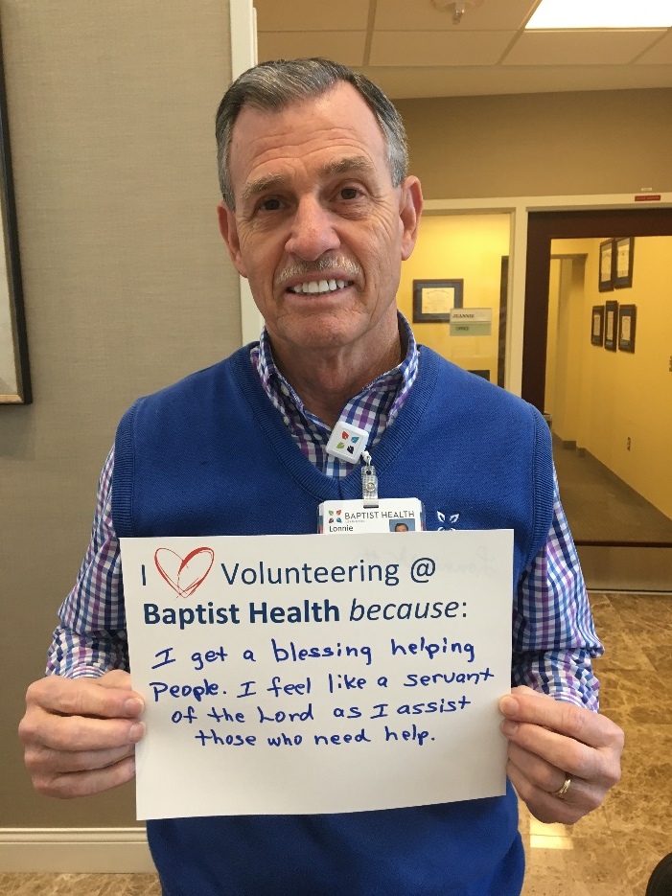
Lonnie Watts: Cancer Center Information Desk
I Volunteering @ Baptist Health because:
I get a blessing helping people. I feel like a servant of the Lord as I assist those who need help.

Slide 29
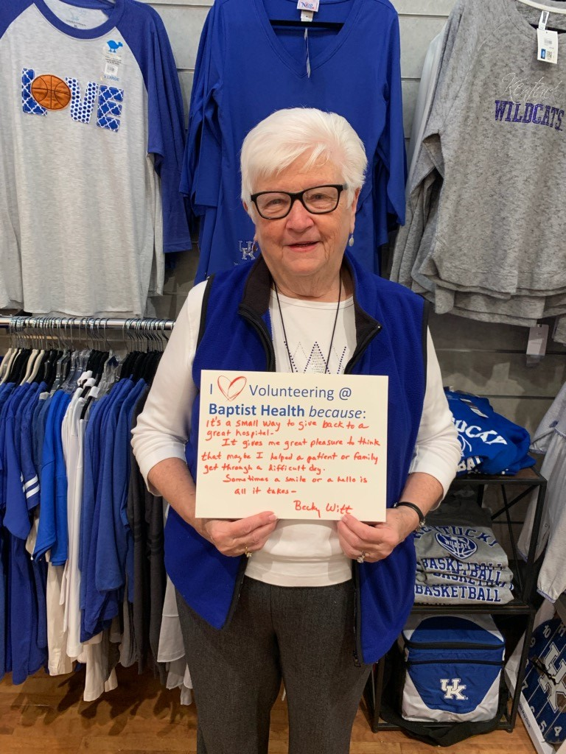
Becky Witt: Gift Shop
I Volunteering @ Baptist Health because:
It’s a small way to give back to this great hospital. It gives me great pleasure to think that maybe I helped a patient or family get through a difficult day. Sometimes a smile or hello is all it takes.

Slide 30
Volunteer Appreciation Week 2020
Notes:
JOHN:
You may remember Candy Field from the last time we were here. She is now in her second year as Auxiliary President and will conclude her term in December. Candy volunteers on a weekly basis in our Emergency Department where she also helps train new adult and college age Volunteers in that area.
Some of you may know Mary Ann Garback, either from church at Calvary Baptist or from her time in the real estate business. Mary Ann will begin as Auxiliary President next January. Mary Ann volunteers faithfully in the Gift Shop.
I’m John Walker, and I serve as Director of Volunteer Services.

